Slide 1
Automatic System Management using Unsupervised Machine Leaning
Xiaohui (Helen) Gu
North Carolina State University

Slide 2





Cloud Computing Challenges
Robustness
Resource and energy efficiency
  Over-provision resources for performance
  Average Resource utilization is 7-12%
2

Slide 3
Major Research Projects
Online system anomaly management
  [SRDS’16, TPDS’15, ICAC’15, IC2E’15, SOCC’14, HotCloud’14, USENIX ATC’14, ICDCS’13, ICDCS’12 (best paper award), ICAC’12, TPDS’12, SLAML’11, SRDS’11, PODC’10, MACOTS’10, ICAC’09, ICDE’09]
  Sponsored by NSF, ARO, IBM, Google
Resource and energy efficient cloud computing
  [ICAC’13, SOCC’11, SOSP’11 (poster), CNSM’10 (best paper award), MASCOTS’10 (best paper nominee), HPDC’10, SOSP’09 (poster), IWQoS’09]
  Sponsored by NSF CSR, two Google research awards, two IBM faculty awards
Security monitoring for cloud and mobile devices
  [ACM CSUR’16, CODESPY’14, TPDS’13, IWQoS’11, ASIACCS’10, CCS’10 (poster), ACSAC’09, STC’09]
  Sponsored by NSA and ARO

Slide 4
Cloud Computing Challenges
Robustness
Resource and energy efficiency
Accountability
4

Slide 5
Existing Approaches
Reactive approaches
  Take corrective actions after an anomaly happens
  No prevention cost but prolonged service downtime
  Difficult to reproduce anomaly-inducing environments
Proactive approaches
  Take preventive actions on all system components
  Provide better system reliability but incur large overhead
  Do not know the underlying reasons
5

Slide 6

Predictive Online System Anomaly Management
C1
C6
C2
C4
C5
C5
C6
C7
C8
C9
C10
Advance
anomaly alerts
Trigger diagnosis
First response
recovery
Online anomaly
prediction
In-situ
Anomaly
diagnosis
(on-going)
Anomaly
removal
(on-going)
Feedback
corrective actions
6

Slide 7
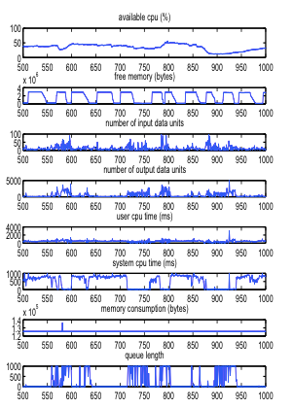
Online System Anomaly Prediction
Performance Anomalies
  SLO violations: response time > 50 ms
Multivariate predictions
  System level metrics: CPU, memory, network, disk I/O
CPU
Anomaly B
Anomaly A
×
×
×
t+30
t+20
Advance Alert with a lead time = 30 time units
t+10
×
Anomaly C
×
t
memory
7

Slide 8
Classification Over Future Data
Anomaly probability
=
Expected probability over the region
Current feature point
Expected posterior Probability
Naïve Bayesian
Neuron Network
Feature value prediction
Discrete-time Markov Chain model
2-dependent Markov model
Wavelet predictions
8

Slide 9
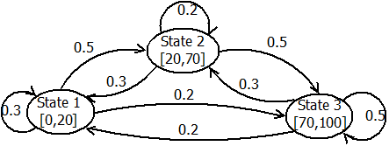
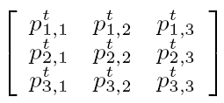
Feature Value Prediction
Predict the metric value distribution at a future time
Discrete-time Markov chain (DTMC)
CPU usage (%) ranging from 0 to 100 with three discrete states
Multi-step state transition matrix e.g. for t-step (i.e. lead time t):
9

Slide 10
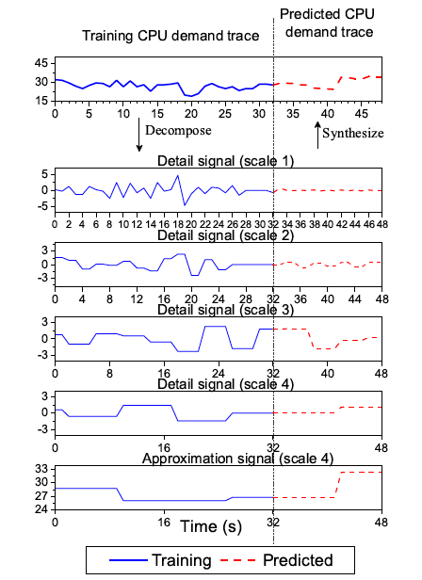
Wavelet-based Medium-Term Prediction
16 iterations
8 iterations
4 iterations
2 iterations
1 iterations
1 iterations
10

Slide 11
Statistical Anomaly Classification
Naïve Bayesian classifier
  Posterior probabilities can be reduced to conditional probabilities
  Each metric is independent
Tree augmented Bayesian (TAN) network
  Consider inter-metric dependencies
  At most one parent other than the class label
Classification rule
x = [x₁, x₂, x₃, x₄]
normal/abnormal
x₁
x₂
x₃
x₄
normal/abnormal
x₁
x₃
x₄
  log P(“abnormal”|x) – log P(“normal”|x) > δ
x₂
11

Slide 12
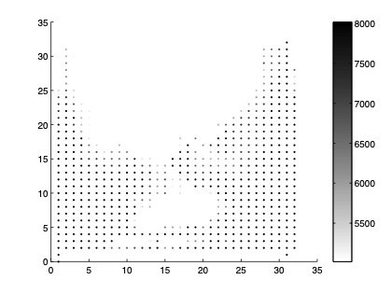
Unsupervised Behavior Learning (UBL)
Support online learning and prediction
  linear time learning and constant time prediction
  Incremental training
Provide hints on root causes
Apache web server
UBL

Slide 13




UBL Learning
Neuron 1
Neuron 2
Color = yellow, Shape = long
Color = orange, Shape = round
Neuron 3
Neuron 4
Color = green, Shape = round
Color = red, Shape = round
Notes:
Mention known and unknown problems can be found

Slide 14

Anomaly Detection and Fault Inference
Neuron 1
Neuron 2
Color = yellow, Shape = long
Color = orange, Shape = round
Neuron 3
Neuron 4
Color = green, Shape = round
Color = red, Shape = round
Notes:
Mention known and unknown problems can be found

Slide 15
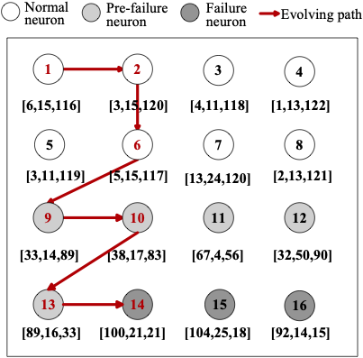
Real Server Example
CPU, memory, network
6 15 116
3 15 119
5 16 117
33 14 90
38 20 80
90 15 30
100 20 20
Network congestion in the Apache web server
Notes:
Mention known and unknown problems can be found

Slide 16
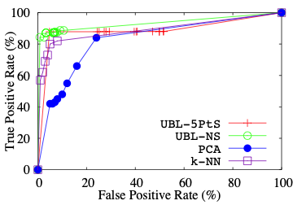
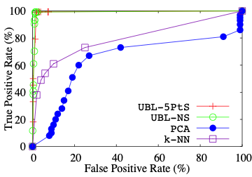
UBL Prediction Results
Memory leak in System S
NetHog in RUBiS
16

Slide 17
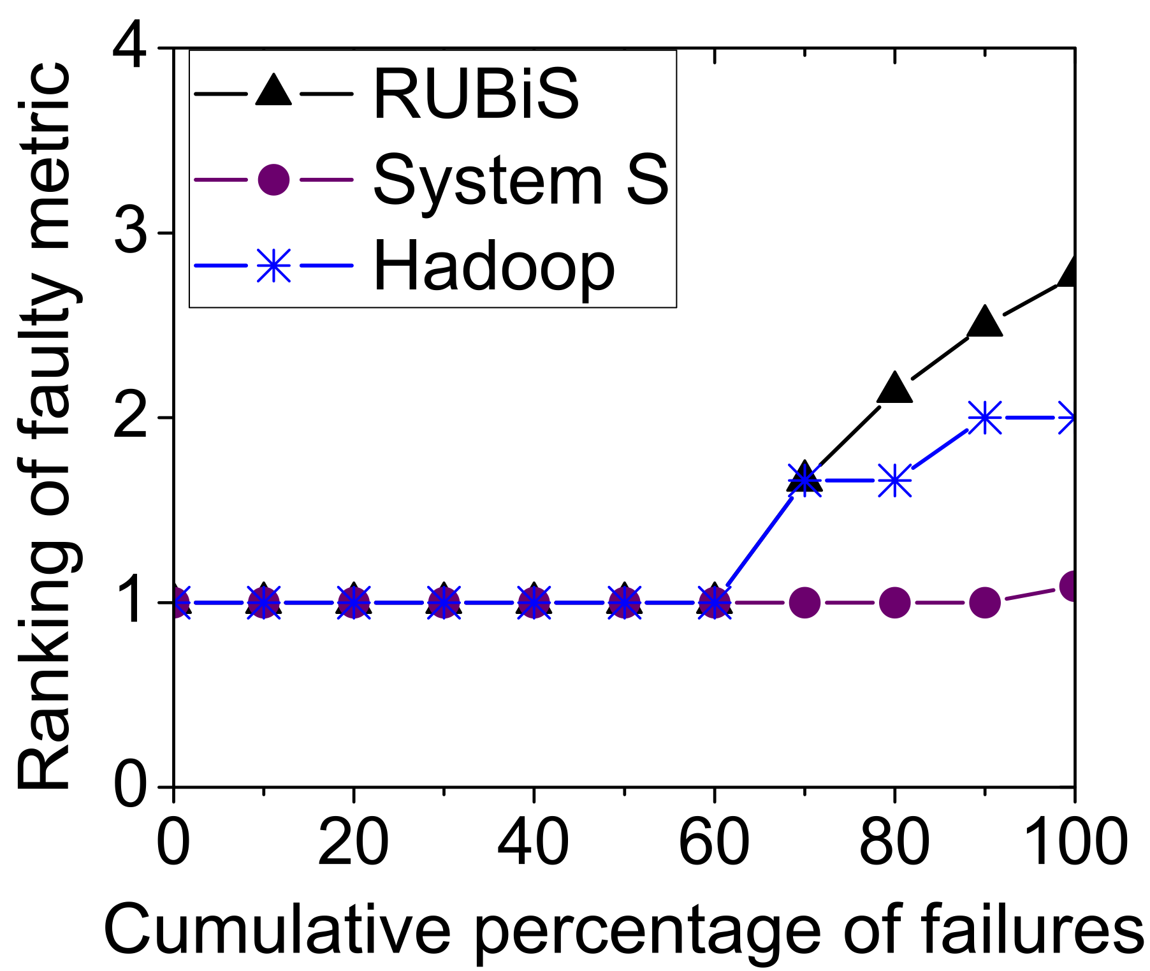
Anomaly Cause Inference Results

Slide 18
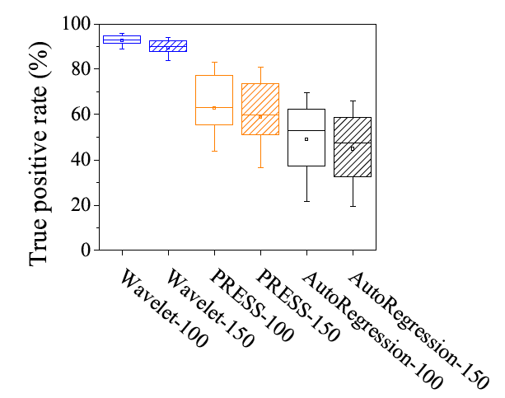
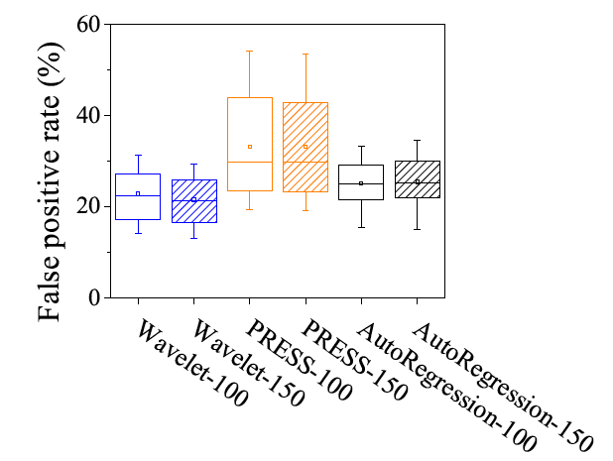
Medium-Term Overload prediction accuracy
Google CPU traces
18

Slide 19
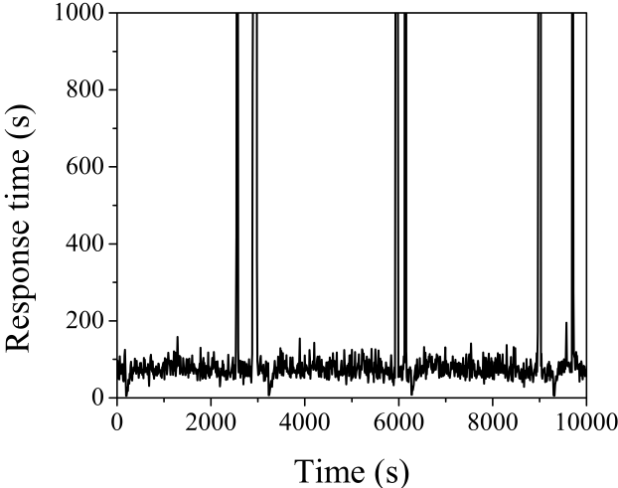
Prediction for Dynamic Systems
Dynamic workloads
Interference from co-located applications
Different or the same problem
(context drift)
19

Slide 20
Context-Aware Anomaly Prediction for Dynamic Systems
More accurate model training
  Induce an ensemble of prediction models from conflict-free training data
Dynamic context discovery
  Does not assume the context information is known
Dynamic prediction model switching
  Predict current context based on context evolving pattern
  Dynamically switch models when context changes
20

Slide 21
Context Discovery
Hierarchical clustering using the cross-validation error
Prediction
Model M₁
Prediction
Model M₂
Prediction
Model M₃
Context C₁
Context C₂
Context C₃
D₁
D₂
D1
D3
D₁
D₃
D₂
d₁
d₂
d₃
d₄
d₅
d₆
d₇
d₈
d₉
d₁₀
d₁₁
d₁₂
d₁₃
d₁₄
d₁₅
d₁₆
time
21

Slide 22
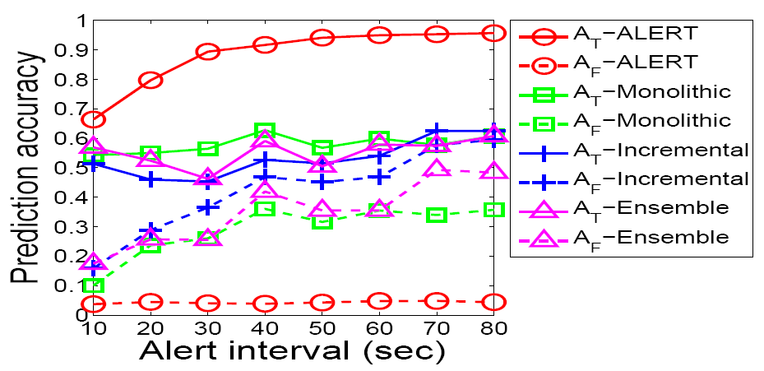
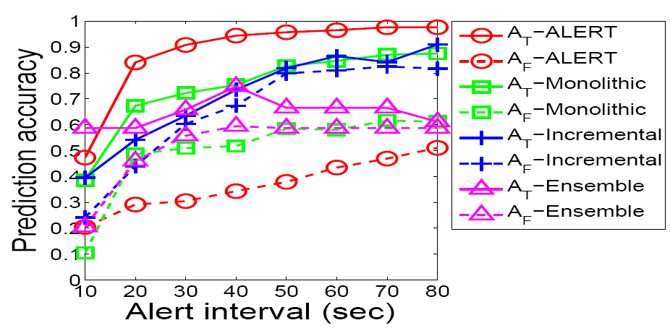
IBM System S Prediction under Dynamic Workloads
Memory Leak
CPU Hog
22

Slide 23
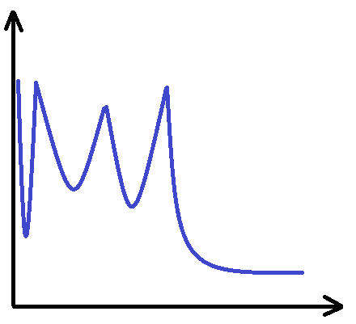

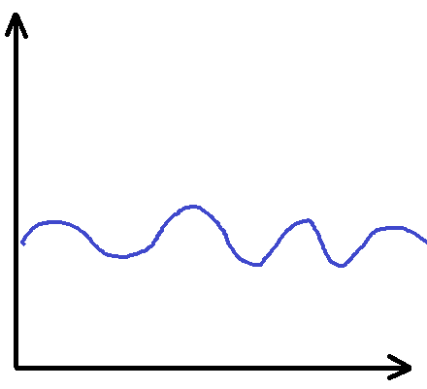

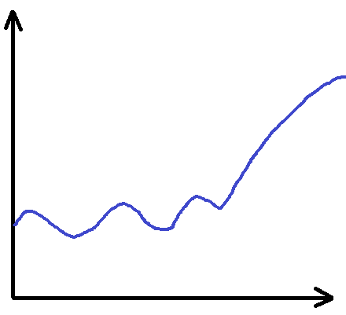

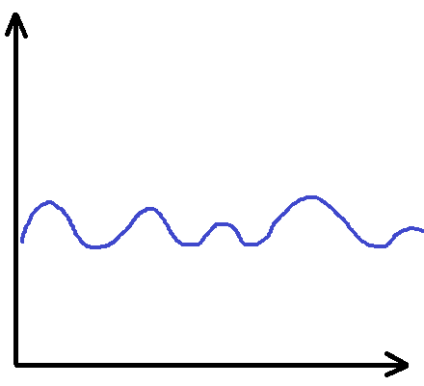
FChain: Propagation-based Fault Localization
t₁
C1
C2
C3
SLO violation!
VM
VM
VM
VM
VM
VM
C4
C5
C6
VM
VM
VM
VM
t₅
VM
C7
C8
C9
VM
VM
VM
VM
t₁ = t₅?
t₁ < t₅?

Slide 24
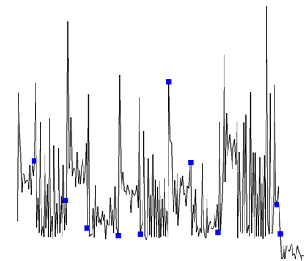
Abnormal change point selection
Mark the onset time of the fault manifestation
SLO violation
Look-back window

Slide 25
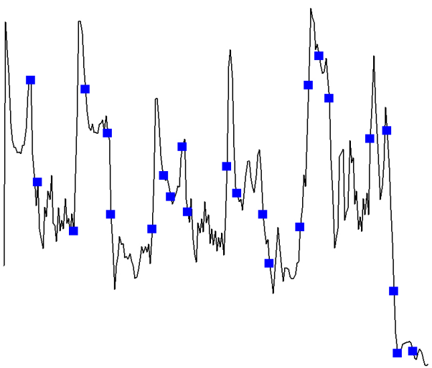
Outlier Change Point Detection
Smoothing
CUSUM + Bootstrap
Outlier detection

Slide 26
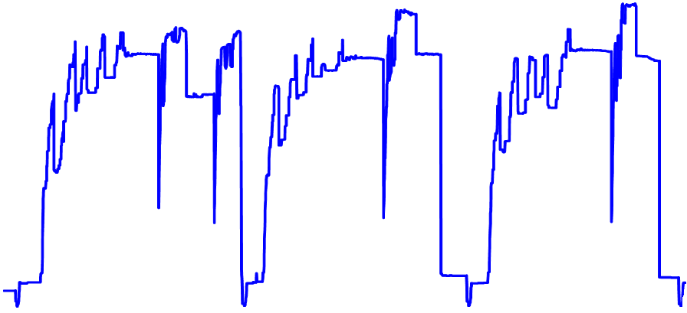
Outlier Change Point Filtering
Change points caused by repeating workload fluctuations are predictable
Memory usage (MB)
Time (s)
Memory usage in a Map node

Slide 27
Outlier Change Point Filtering
Employ online learning models to capture normal fluctuations in system-level metrics
  Markov chain model [Gong et al., CNSM’10]
  Predict value at each change point
Examine the prediction error (α = |y – y|) of each outlier change point
  Low (e.g., α ≤ ε): normal change point
  High (e.g., α > ε): abnormal change point

Slide 28
Propagation-based Fault Localization
Workload change
  Full coverage
  Change points have the same upward trend
C1
C2
C3
C1
C2
C3
C0
C7
C0
C7
C4
C5
C6
C4
C5
C6
Full coverage
Partial coverage
28
Notes:
Ok. After identifying the onsets of anomaly behavior of all the components PAL server starting doing fault localization
it classifies the behavior into 2 cases;
First, if all the components have the critical change point (which is corresponding to the onset of anomaly behavior), it is the full coverage case. Otherwise, if only some components have the critical change point, it is the partial coverage case.
If it detects the full coverage case and all the change points have the same trend, the root case is the external factors such as workload change

Slide 29
Faulty Component Pinpointing Results

Slide 30
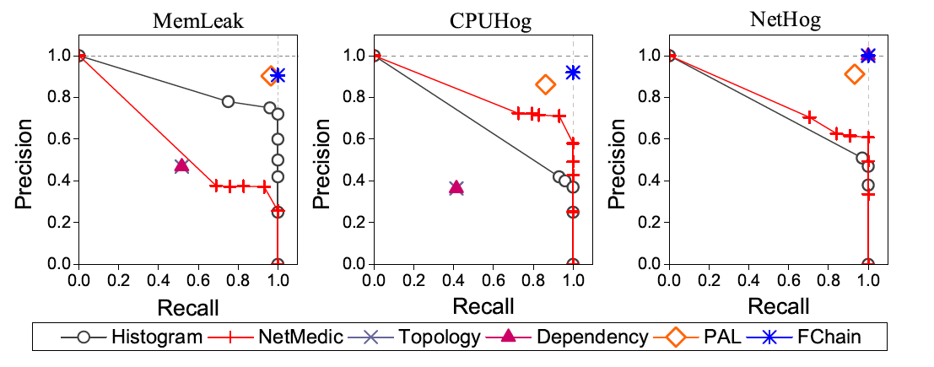
RUBiS Pinpointing Results
30

Slide 31
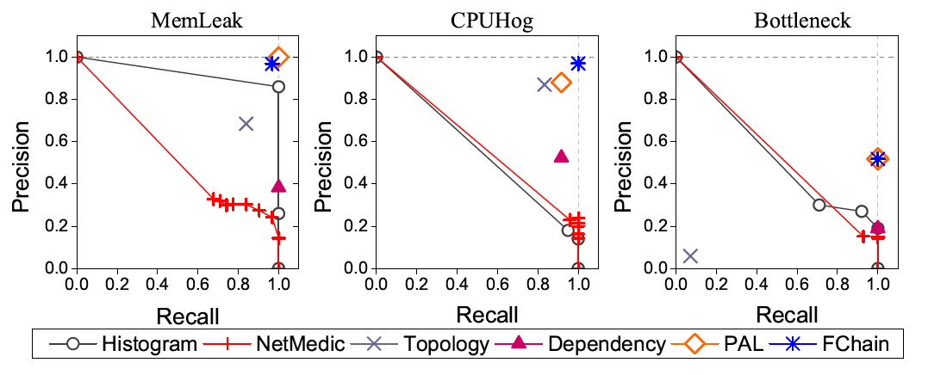
System S Pinpointing Results
31

Slide 32
Predictive Anomaly Prevention
Pinpoint faulty components
  Anomaly propagation based pinpointing
Coarse-grained anomaly cause inference
  Metric attribution
Safe, reversible intervention
  Dynamic resource scaling
  Live VM migration
Online validation
  Check whether anomaly alerts are gone
  Compare resource usage before and after prevention
32

Slide 33
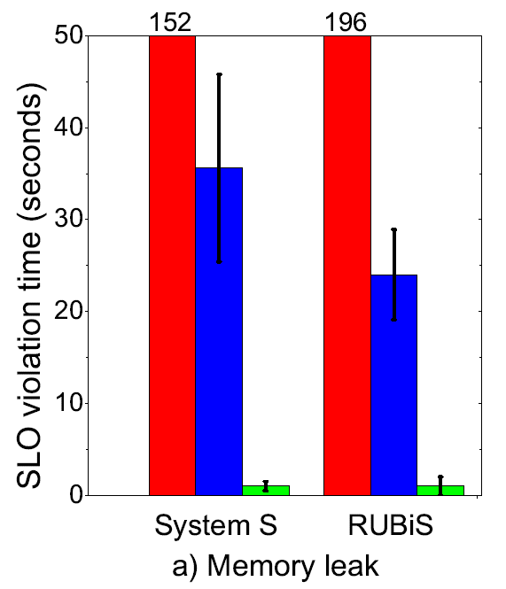
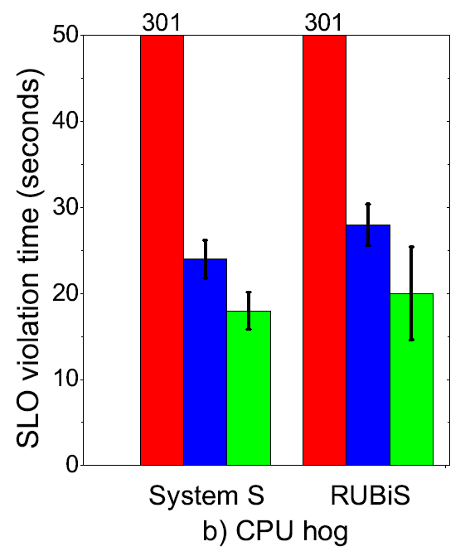
Predictive Performance Anomaly Prevention
SLO violation time comparison using
the live VM migration as the prevention action.
33

Slide 34





PerfCompass: Runtime Performance Anomaly Fault Localization
Fault Feature Extraction
VM
VM
VM
VM
System Call Trace
PerfCompass
VM
VM
VM
VM
Internal or External?
Internal fault!
34

Slide 35
System Architecture
PerfCompass
System call trace
Physical host
Application & VM
Execution unit extraction
Linux kernel tracing module
Fault onset time identification
System call trace
Performance anomaly alert
PerfCompass
Fault localization schemes
Xen/KVM hypervisor
Internal or External?
35
Notes:
Mention system calls

Slide 36
Experimental Evaluation – External Faults
System Name | Fault Description | Fault Impact Factor | Fault Onset Time Dispersion
Apache | CPU cap | 100 +/- 0 % | 7 +/- 1ms
Apache | Packet loss | 100 +/- 0 % | 4 +/- 1ms
MySQL | I/O interface | 100 +/- 0 % | 15 +/- 7ms
MySQL | CPU cap | 94 +/- 2% | 17.77 +/- 4ms
Squid | Packet loss | 100 +/- 0 % | 0.01 +/- 0.001ms
Cassandra | CPU cap | 99 +/- 1.4% | 28 +/- 4ms
Cassandra | I/O interference | 100 +/- 0% | 9 +/- 1ms
Hadoop | CPU cap | 98 +/- 1% | 39 +/- 5ms
Hadoop | I/O interference | 98 +/- 0% | 16 +/- 3ms
36

Slide 37
Experimental Evaluation – Internal Faults
System Name | Fault Description | Fault Impact Factor | Fault Onset Time Dispersion
Apache | Flag setting bug | 50 +/- 0.5 % | 374 +/- 63ms
MySQL | Deadlock bug | 40 +/- 0 % | 38 +/- 3ms
MySQL | Data flushing bug | 62 +/- 3 % | 721 +/- 4ms
Squid | File access bug | 83 +/- 1 % | 0.35 +/- 0.09ms
Cassandra | Endless loop | 51 +/- 5.7 % | 25 +/- 0.98ms
Hadoop | Endless read | 81 +/- 0 % | 23 +/- 6ms
Hadoop | Thread shutdown | 85 +/- 0.5 % | 110 +/- 20ms
37

Slide 38

PerfScope: Online Performance Bug Inference
Offline Profiling
Online
Affected
functions
read()
doIO()
…
read()
VM
VM
VM
VM
sys_read
Function trace
Affected system call trace
sys_read
System call trace
Affected functions
read()
doIO()
PerfScope
Offline
PerfScope Runtime
read() : sys_read
Application profile

Slide 39
Online Bug Inference Results
System Name | Percent of Identified Functions | Example Bug Related Function
Hadoop | 0.52% | getState(4)
HDFS | 1.5% | Reader.performIO(3)
Cassandra | 0.6% | maybeSwitchMemtable(4)
Tomcat-1 | 1.5% | addLifeCycleListener(2)
Tomcat-2 | 0.8% | LimitLatch.countDown(11)
Tomcat-3 | 0.4% | Poller.run(3)
Apache-1 | 0.7% | apr_allocater_mutex_get(14)
Apache-2 | 2% | ssl_hook_pre_connection(9)
Lighttpd-1 | 0.1% | fdevent_poll(1)
Lighttpd-2 | 0.08% | connection_handle_read_state(3)
MySQL-1 | 0.6% | Ha_lock_engine(14)
MySQL-2 | 0.03% | buf_flush_list(4)

Slide 40
Cloud Computing Challenges
Robustness
Resource and energy efficiency
Accountability
40

Slide 41
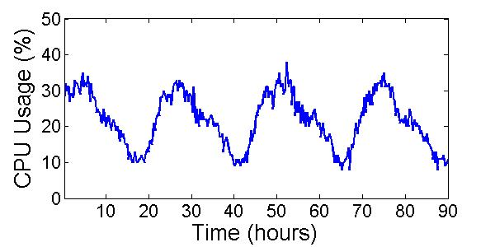
  Elastic Resource Scaling
Cannot assume prior application knowledge
Save energy with SLO conformance
Over-provisioning (waste)
Under-provisioning (SLO Violations)
Over-provisioning (waste)
Always just enough resources
Max
Mean
Ideal
Apache web server under real server workload

Slide 42
Predictive Elastic Resource Scaling
Do not require advance application profiling or modeling
Resource usage monitoring
Resource usage time series
Virtual Machine
(KVM, Xen)
Prediction model
(Markov + FFT, Wavelet)
Resource demand prediction
Prediction-driven resource scaling (Adaptive resource padding, fast error correction)
Adjust resource cap
Live VM migration
Live VM cloning (pre-copy)
Dynamic frequency & voltage scaling
42

Slide 43
Prediction-driven Scaling Problems
CPU usage (%)
Under-estimation
error
Over-estimation
error
Time (s)

Slide 44
Under-Estimation Prevention
Burst & remedial padding
CPU usage (%)
Time (s)

Slide 45
Fast Under-Estimation Correction
Exponentially increase the resource cap
CPU usage (%)
Time (s)

Slide 46
Predictive Frequency and Voltage Scaling for Energy Saving
Total CPU usage (%)
Freq: 2.0 GHz
Freq: 1.0 GHz
Time (s)

Slide 47
Predictive Live VM Migration
Trigger Migration
Migration lead time
Conflict
VM
VM
CPU usage (%)
Conflict prediction, resolution inference and predictive migration
Time (s)

Slide 48
Elastic Auto-Scaling
Elasticity: grow/shrink resource as required
VM
VM
VM
VM
CPU demand
VM
VM
VM
Time

Slide 49
AGILE System Overview
SLO violation feedback
Resource usage monitoring
Resource demand prediction
Resource pressure modeling
VM
VM
VM
VM
VM
VM
VM
VM
VM
Server pool prediction
VM
add/remove
Server pool scaling manager
AGILE

Slide 50
Experimental Evaluation
Implemented on top of Xen and KVM
Benchmark systems
  Real resource usage traces from 100 machines in a Google cluster
  RUBiS driven by real server workload traces
    WorldCup' 98, EPA, NASA, ClarkNet
  Hadoop
    Word Count, Grep
  IBM System S
    Tax calculation application
50

Slide 51
Summary of Experimental Results
Prediction accuracy
  <10% prediction error
SLO conformance
  SLO violation rate: 50% → 2-8%
  SLO violation time during conflicts: 350 → 60 seconds
Energy saving
  8-10% total energy saving and 39-71% workload energy saving with little impact on the application performance
ACM SOCC 2011
51

Slide 52
Overload handling
Web server: during scaling

