Slide 1
Predictive and Adaptive Failure Mitigation to Avert Production Cloud VM Interruptions
Authors: Sebastien Levy, Randolph Yao,
Youjiang Wu, Yingnong Dang and others
Presenter: Gaolin Zhang
02/23/2023

Slide 2
Introduction
Cloud systems are scaling up…
Detection and Mitigation: Before or after?
Mitigation actions: how to decide?
Previous research: mainly focuses on detection, not mitigation
Cloud systems are changing radically

Slide 3
Introduction
Narya
Failure Detection
predicts failures based on multi-layer system signals
decides smart mitigation actions based on the signals
Mitigation
keep its decision engine updated by taking a novel online experimentation approach
enhances the adaptive decision capability through reinforcement learning

Slide 4
Background and Motivation
A traditional system’s operation cycle
Target system and goal
Why reacting on predicted failures?
Why static mitigation is insufficient?

Slide 5
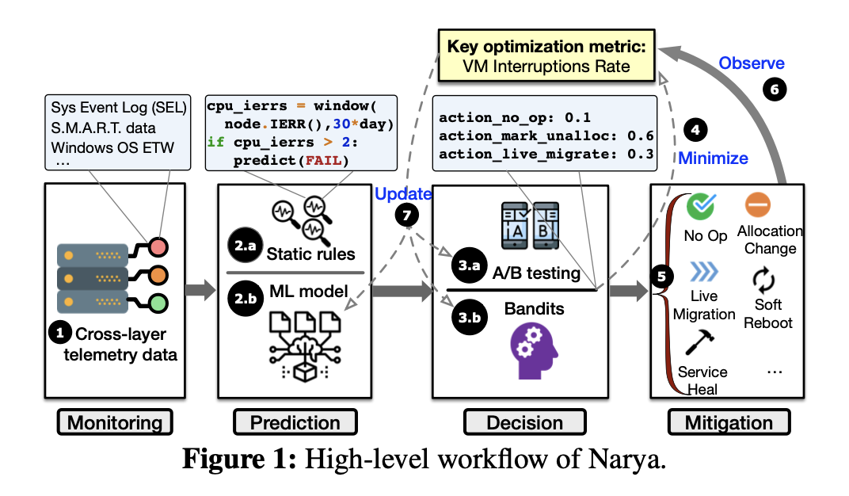
Overview

Slide 6
Overview
Key optimization metric
Annual Interruption Rate (AIR)
Reasons to optimize this metric
Future challenges

Slide 7
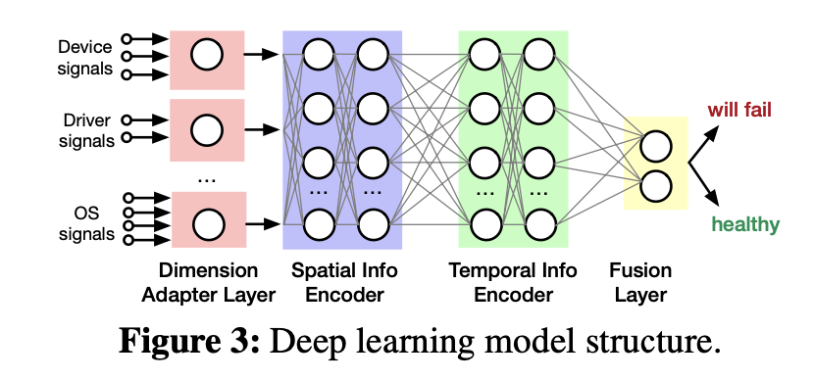
Predicting Node Failures
Input signals
Rule-based prediction
Learning-based prediction

Slide 8
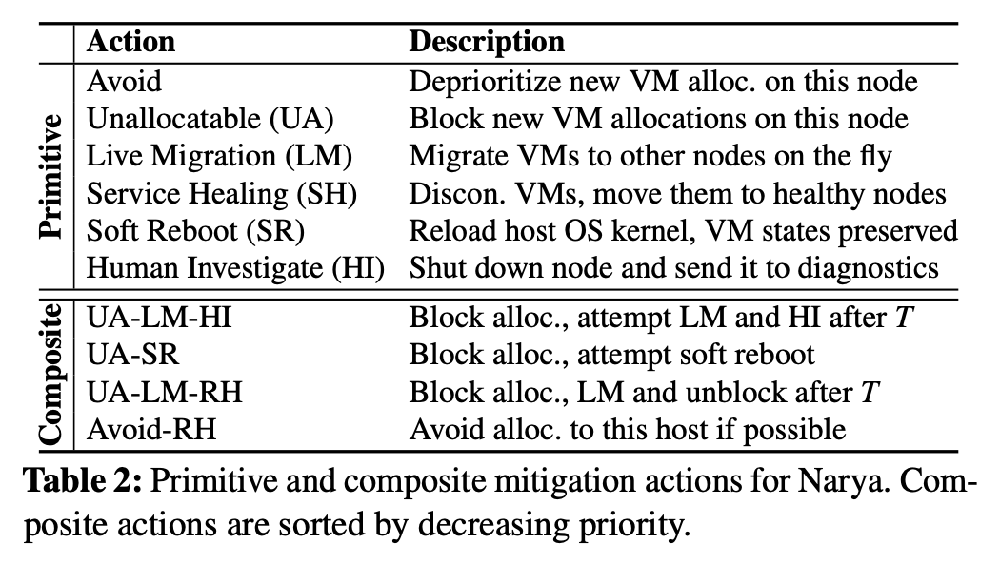
Mitigation Actions

Slide 9
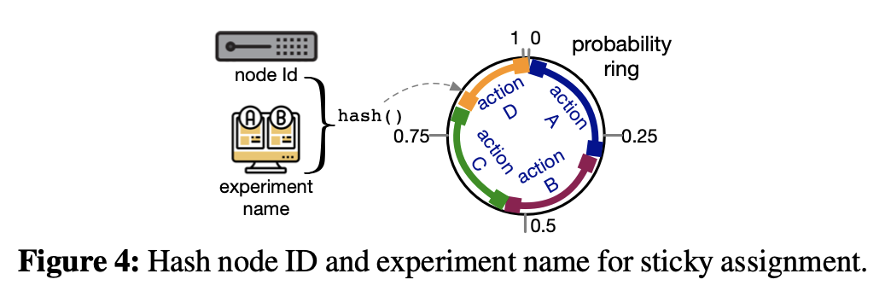
Decision Logic for Adaptive Mitigation
Online Experimentation with A/B Testing
Bandit Modeling
Thompson Sampling Model

Slide 10
Experiment and Evaluation
Several questions before the experiment
VM interruption savings: 26.2%
Accuracy and Timeliness of Prediction:
Overall precision: 79.49%
Overall recall: 50.7%
False positive rate: 20.51%
Comparing A/B Testing and Bandit

Slide 11
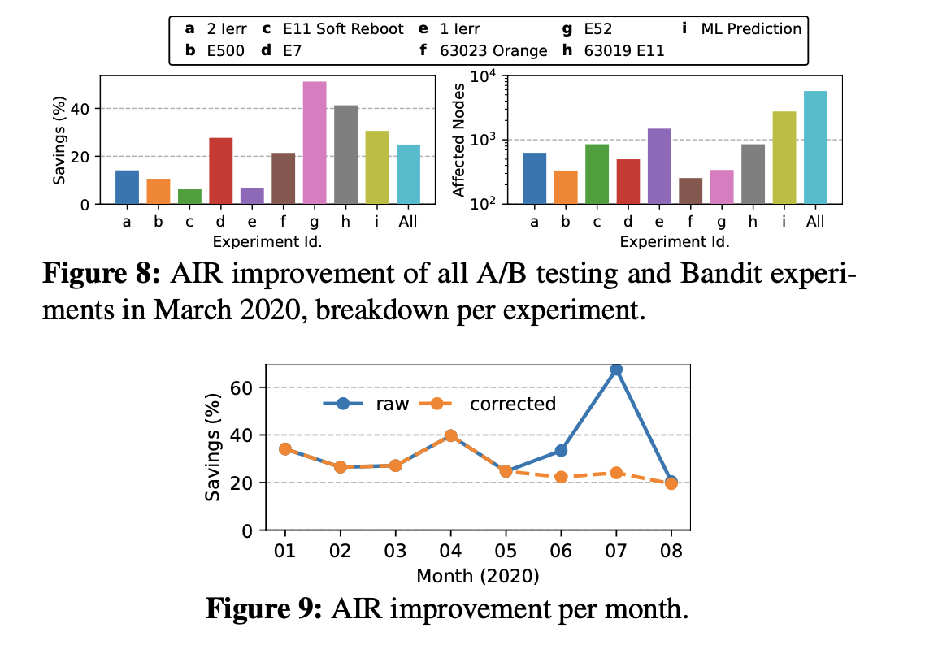
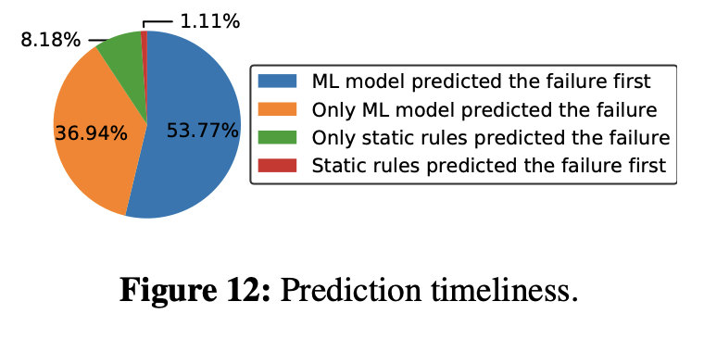
Experiment and Evaluation

Slide 12
Thanks!

