Slide 1
Testing Configuration Changes in Context to Prevent Production Failures
Authors: Xudong Sun et al
Presenter
Vinay Vasudev

Slide 2
Introduction
Large scale cloud services evolve rapidly and deploy hundreds to thousands of configuration changes to production systems daily.
Faulty configurations are second largest cause of service disruptions in Google production service.
At Facebook 16% of service level incidents, including major outages are caused by config changes
Notes:
. For example, at Facebook, thousands of configuration changes are committed daily, outpacing the frequency of code changes [55]. Other cloud services such as Google and Azure also frequently deploy configuration changes. The high velocity of configuration changes has led to frequent configuration induced failure

Slide 3
Introduction (contd.)
Configuration changes induce two types of production system failures
Dormant bugs in the system exposed by valid configuration changes
Erroneous configuration values causing unexpected behavior
Notes:
Based on the authors’, analyses on hundreds of configuration-induced incidents, failure-inducing configuration changes are rarely caused by trivial mistakes (e.g., typos). This rarity is attributed to the DevOps practices that enforce change review and validation. Because of this the root causes of configuration-induced failures are often non-trivial and they commonly reside in the program and not in the changed configurations.
The root causes of the former are in the program, while the latter are often due to configuration design or implementation flaws

Slide 4
Motivation
Existing techniques only check configuration values and cannot detect configuration changes that cause code to fail.
It is hard to codify and maintain human-written or machine-learned rules.
Software testing is hard to cover all possible configuration value combinations.
Notes:
This is because The root cause is outside the configuration
to check the often subtle, version-specific, and inconsistent configuration requirements.
As a workaround you can test few representative ones(default ones) •
But, production system configurations may not be tested • Production configurations are the ones that matter

Slide 5
Contributions of paper
Ctest: A new perspective in detecting failure inducing configurations
Key idea: connect production system configurations to software tests
Checks program behavior against configurations to be deployed
Detects both types of failure-inducing configuration changes
A methodology of generating ctests from existing software tests
Evaluations on the effectiveness of ctests in different scenarios
Notes:
That is erroneous config changes and valid config changes that expose dormant software bugs.

Slide 6
Definition
A ctest is a software test parameterized by configuration parameters.
Run by instantiating input configuration parameters with concrete values
Exercise system code and assert program behavior.
Can be a unit, an integration, or a system test
Notes:
Ctest is run by instantiating input config parameters with concrete values, that is the values to be deployed in production
It Can be a unit, an integration, or a system test depending on the usage

Slide 7
Example
@Ctest
public void testRefreshCallQueueProtocol() { Configuration conf = new Configuration();
Server server = new Server(conf);
server.authorize(...);
...
}
Prod Config
…
…
…
-authz = false
+authz = true
void authorize(...) {
if (authz) {
acls = protocolToAcls.get(...);
if (acls == null)
throw new AuthorizationException(...);
}
}
Notes:
Here is an example of a ctest that has been generated from hadoop test suite. This ctest first loads the production configuration into the configuration object. Then this production configuration is used to construct a serve and call authorize method on the server. If a devops engineer change the production configuration parameter authz from false to true. Then in this method the true branch depending on this configuration parameter gets executed and bug in this branch will be triggered and causes hadoop to fail in production. Where as if you run this ctest before executing in a production environment, then this can detect this bug in pre-production itself caused by valid configuration change.

Slide 8
Ctests can be used for..
Checking entire system configuration
Checking a configuration diff
For each configuration diff, only rerun relevant ctests
Checking a configuration file
A configuration file is a "diff" over the default system configuration

Slide 9
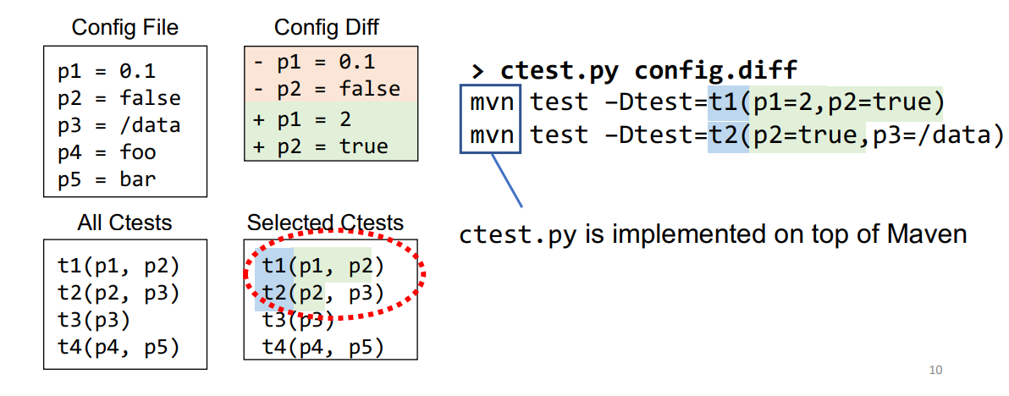
Using ctests to check a configuration diff
Rerun only ctests that exercise changed configuration parameters

Slide 10
Ctests can be transformed from existing tests
Mature software projects have high-quality test code
70+% statement and method coverage in the evaluated systems
Higher coverage is reported in commercial projects.
Reuse existing well-engineered test logic and oracles
Notes:
How do you write ctests.

Slide 11
Transforming existing tests into ctests
Identify configuration parameters exercised by an existing test
Instrument configuration APIs
Connect existing tests to the production configuration
Intercept configuration APIs
Respect explicit and implicit test assumptions on configurations

Slide 12
Step 1: Instrumentation (example from Hadoop)
Configuration interfaces(used in test code)
String get(String parameter);
Read
Key-value configuration store
void set(String parameter, String val);
write
Notes:
I use hadoop as an example to demonstrate how to do instrumentation, idea is applicable to other static systems. Hadoop uses a key value store to maintain mapping of configuration internally. There are two basic configuration APIs. First is get API which is used to read config value of a particular config parameter from key-value config store and then set API to write config value of a config parameter to key value store. Certain variations like getInt, getBoolean are present but they all eventually call get API itself. These type of APIs exist in other mature software systems as well.

Slide 13
Step 1: Instrumentation (example from Hadoop)
Configuration interfaces(used in test code)
String get(String parameter){
…
}
Read
Key-value configuration store
+ LOG.info(“[GET] ” + parameter);
@Test
void testRefreshCallQueueProtocol
{...
authorize = conf.get(“hadoop.security.authorization”);
...
}
Notes:
Inside the get API we insert logs like and and log the parameter and by running all the tests once and parsing the test logs that we have obtained we can get to know which configuration parameters are exercised during the test run

Slide 14
Step 2: Interception (example from Hadoop)
Configuration interfaces(used in test code)
String get(String parameter){
LOG.info(“[GET] ” + parameter);
…
}
Read
Key-value configuration store
2. Configuration initialization
static {
addDefaultResource(“core-default.xml”);
addDefaultResource(“core-site.xml”);
addDefaultResource(“core-ctests.xml”);
} production config
Initialization
Notes:
Second step is to intercept the config API to make the test exercise the production configuration. In hadoop the key value configuration store is initialized using the static block. The first is the default configuration, second is the test configuration. Each loading step will override the previous loading value, so we need to load one more configuration which is that of the production configuration. In this way the key value configuration store will be initialized by the production configuration values and tests will exercise production configuration by using the get api

Slide 15
Step 3: Respect test assumptions on configurations
Tests can explicitly reset configuration values
Tests can also implicitly assume configuration values (w/o explicit reset)
Notes:
Tests will raise false alarms if this assumptions are broken. Even though a valid configuration value is passed. Lets look at a test example for this

Slide 16
Step 3: Respect test assumptions on configurations
@Test
public void testNameNodeXFrameOptionsEnabled() {
…
conf.set(“dfs.xframe.enabled”, “true”);
…
String xfoHeader = conn.getHeaderField(“X-FRAME-OPTIONS”)
…
Assert.assertTrue(xfoHeader.endswith(XFrameOption.SAMEORIGIN));}
Explicit assumption
Implicit assumption
conf.get(“dfs.xframe.value”)
Default value of dfs.xframe.value
Notes:
This test is used for testing xframe feature for NameNodes. This particular line set the configuration parameter dfs.xframe.enabled to true, further lines are based on the assumption that its value is always true. This line checks if the xfoHeader ends with the XframeOption. This is an implicit assumption since this value comes from another config parameter called dfs.xframe.value. default value of dfs.xframe.value is SAMEORIGIN. They have hardcoded this assertion to take always the default value. So, it fails on any other valid value apart from the default value which is false alarm.
To detect explicit assumption we instrument all the set apis by logging the configuration parameters just like we did for get API.
t. Again by instrumentation, It does so by parsing the logs generated by instrumented SET APIs and excluding parameters that are reset from configuration value which we had passed.
For implicit assumption we run the test by instantiating it with few other valid values.. If tˆfails on a valid value, then this means that it has some implicit assumption.
In order to respect the test assumptions made on these configurations we do not include these tests to test these configuration parameters But this test can be used to test other config parameters which are not affected by these assumptions
Optionally we can manually rewrite this test so that it takes value from the configuration , by doing this test is no longer making implicit assumptions so we can use this test to test this configuration parameter..
However, the heuristics are simple and practical—only 1.6% of the generated values were invalid due to hidden constraints (§5.3). Our heuristics could not generate valid values for about 16% of parameters: enum options, class names, and commands. We manually selected valid values in these cases

Slide 17
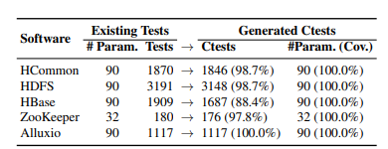
Generating ctests
Selected 392 config parameters in five cloud systems
Generated 7000+ ctests for all the selected configuration parameters
Notes:
The small percentage of tests that could not be transformed as ctests were hardcoded to specific values of all the parameters that they exercise—a ctest is generated as long as it can check at least one configuration parameter.
Note that we sampled 90 parameters mainly to bound our manual inspection effort for analyzing effectiveness and false negatives

Slide 18
Evaluation
How effectively do ctests prevent configuration-induced failures?
64 real-world configuration-induced failures.
Ctests detected 62 out of 64 failure-inducing configurations.
Notes:
They reproduced 64 real-world configuration induced failures from the issue tracking database of the five systems. .
Each failure was reported by real system users and was caused by a configuration change (i.e., a value different from the default was used). These 64 failures have diverse root causes, including 51 misconfigurations and 13 software bugs exposed by valid configuration changes. For each failure, they identify each configuration parameter and its value in the failure-inducing configuration change and generated ctests based on the method that I described earlier. The results are promising.

Slide 19
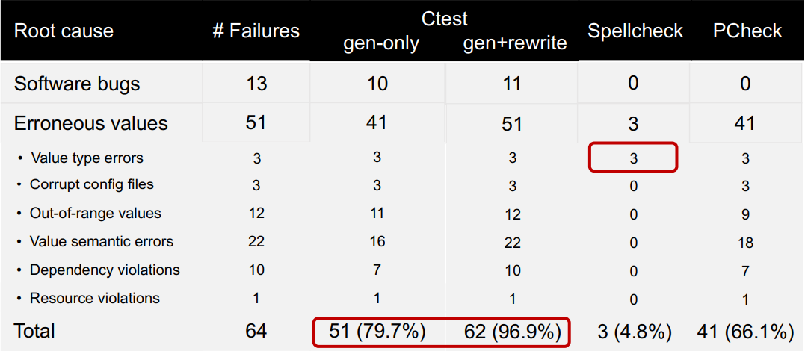
Ctests evaluation
Notes:
96.9% (62/64) of the failure inducing configurations are detected by ctests. All failures due to misconfigurations are detected. Specifically, 79.7% (51/64) of all failures are detected by using only generated ctests; the other 17.2% (11/64) require rewriting of ctests. . In 9 of the 11 failures that require rewriting, they only remove unnecessary value resets. In the other two, they also change an assertion.
value semantic errors refer to misconfigurations that violate the semantics of the configuration parameter, including invalid file paths, URI, IP addresses, permission masks, etc
They compared ctests with other two stateof the art configuration checking techniques, PCheck [67] and Spellcheck. Spellcheck only detects value-type errors. Although PCheck detects around 66% of the failures, it cannot detect failures which have a non crashing behaviour, misconfigurations involving operations that have side effects eg writing to a file and those that require client side interactions.
Two of the 64 failures were not detected by ctests [2,80]. In ALLUXIO-9810 [2], the root cause is a buggy shell script that no test invoked. The root cause of ZOOKEEPER-2299 [80] is a bug in a method that no test in the reported ZooKeeper version exercised. Both bugs can be detected by extending the test suite. In fact, for ZOOKEEPER-2299, the latest ZooKeeper version includes a test from which we have now generated a ctest that detects this bug.

Slide 20
Ctests evaluation
How effectively do ctests detect diverse types of misconfigurations?
1,055 synthesized misconfiguration values.
72% were detected by the generated ctests.
How do ctests detect misconfigurations in the wild?
92 configuration files collected from public docker images.
10 misconfigurations in 7 configuration files
Notes:
The generated ctests failed to detect 28.4% (300 of 1055) injected misconfigurations, i.e., false negatives. The results are consistent with the evaluation of misconfigurations without rewriting in §6.1. Recall that we do not rewrite tests in this evaluation, which could improve ctest adequacy (§6.1). We inspected the 300 false negatives. 75.3% of false negatives are due to inadequacy of ctests that either does not expose the effects of the misconfigurations or does not have oracles to check the effects. Many of these effects are nonfunctional (e.g., performance issues). Moreover, unlike realworld failures (§6.1), many injected misconfigurations are expected to be uncommon in practice. So, the systems have no error-checking logic or test code.
. We run ctests against the configuration files on our server, rather than deploying the ctest infrastructure in each image’s container to reduce the cost of resolving dependencies and setting up environments (many images are built from old OS distributions with incompatible dependencies).

Slide 21
Limitations
Ctest effectiveness relies on the quality of tests.
The two missing cases are due to lack of effective tests.
One missing case can be detected by a ctest generated in the latest test suite
Ctest generation methods are neither sound nor complete
Ctests do not bridge the gap between testing environment and production environment.
Notes:
First, the heuristics for detecting implicit test assumptions (§4.2.2) are unsound and could lead to false negatives in detecting bugs
Second, dynamically tracing test executions to identify parameters exercised in tests is incomplete, because configuration changes could lead to different execution paths.

Slide 22
Strong points
Introduces ctests which give a new perspective to detect failure induced configurations.
Gives a methodology of generating ctests from existing software tests.
They show that ctests effectively detect real-world configuration-induced failures early, during testing.
Code and datasets are provided to playaround and to understand the generation process.

Slide 23
Weak points
They should have taken atleast one not so famous system and estimate the amount of time taken to generate ctests there.
No information on ctest selection and prioritization techniques.
May lead to false positives and false negatives due to mismatch between the test and production environment.

Slide 24
Possible improvements
Heuristics to automatically generate values for implicit assumptions, could not generate values for enum options, class and commands. Integrate advanced inference tools.
Ctests cannot localize the root causes of configuration induced failures. Fault localization for configuration-induced failures can be developed to automate root cause analysis.
Notes:
Like SPEX, confSeer and so on.
Fault localization techniques such as Slice-Based Techniques and Program Spectrum-Based Techniques
However, a few failures take considerable time to understand, due to (1) complexity of configuration value propagation and transformation, or (2) unexpected, hidden configuration constraints

Slide 25
Related work
Xu, T et al. Early Detection of Configuration Errors to Reduce Failure Damage.
Mehta S et al. Rex: Preventing Bugs and Misconfiguration in Large Services using Correlated Change Analysis
Tillmann, N., and Schulte, W. Parameterized Unit Tests.
Notes:
Ctests is complimentary to their prior work PCheck. PCheck is a post-deployment technique. can only detect misconfigurations, because it considers only statements on the data-flow path of each configuration value.,whereas ctests can detect valid configuration changes that expose bugs in the code, a common type of failure-inducing configuration changes
Rex detects only specific type of misconfiguration, it detects dependency violations between source-code files and configuration files which should be updated together. Ctests are not specific to any type of misconfigurations or software bugs
The goal of PUTs is to allow developers rerun the same test against different inputs, to cover more program paths. The goal of ctests is to connect production system configurations to software tests, to find failure-inducing configuration changes. The inputs to PUTs are either specified by developers or automatically generated by symbolic execution, but the inputs to ctests are read from the system configuration files or diffs

